Slide 1


React + A.I.
Building modern Web components using LLMs

Slide 2
React 101
https://github.com/marcus-yeagle/react-tutorial
https://react.dev/learn/tutorial-tic-tac-toe (source)

Slide 3
React 101
Setup - will give you a starting point to follow the tutorial.
Overview will teach you the fundamentals of React: components, props, and state.
Completing the game - will teach you the most common techniques in React development.
Adding Time Travel - will give you a deeper insight into the unique strengths of React.
Finally - Make A.I. do all the work

Slide 4
React 101
Setup - will give you a starting point to follow the tutorial.
Overview will teach you the fundamentals of React: components, props, and state.
Completing the game - will teach you the most common techniques in React development.
Adding Time Travel - will give you a deeper insight into the unique strengths of React.
Finally - Make A.I. do all the work

Slide 5

Functional Programming (FP)
- Lambda Calculus (Church, Princeton 1930)
- LISP (McCarthy, Caltech 1959)
- Scheme (Sussman/Steele, M.I.T. 1975)
- LiveScript (Eich, NetScape 1995)

Slide 6
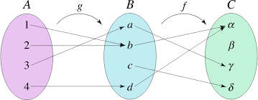
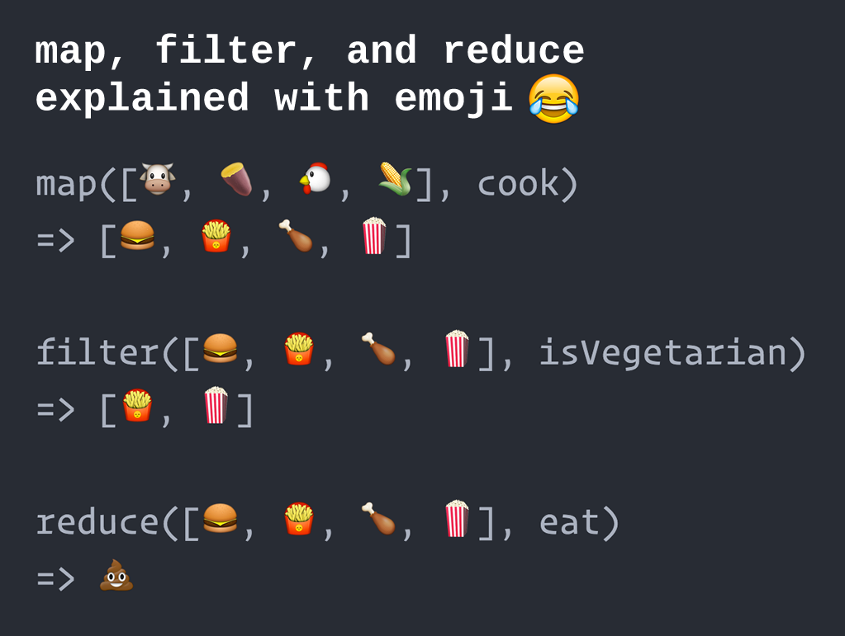
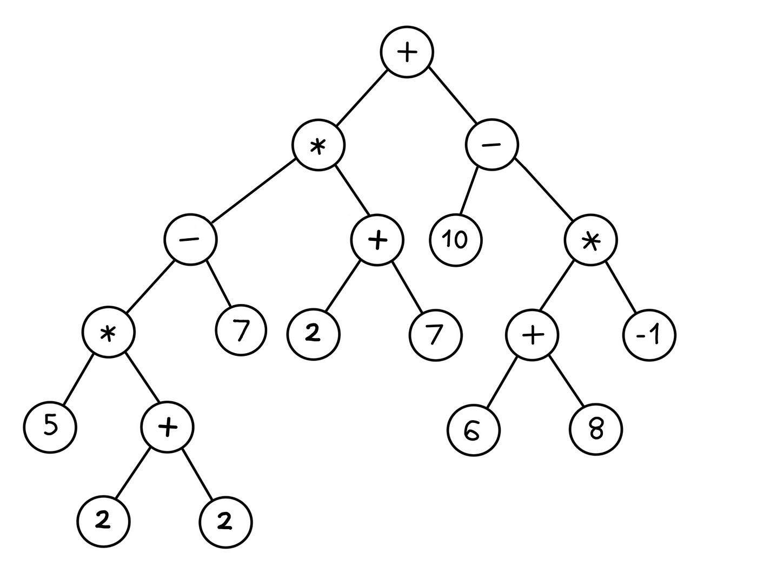
Functional Programming (FP)
- Applying and Composing Functions
- Trees of Expressions
- Map values to values instead of sequence of imperative statements updating the state
- First-class Functions (functions as values)

Slide 7
JavaScript (TS) refresher
Object Literals
{foo: ‘bar’, bin: 42}
Array Literals
[[2, 3, 5], [‘foo’, ‘four’, ‘five’], [1, true, ‘false’]]
Functions Literals
() => { console.log(42) } (anonymous lambda)
((n) => n+1)(3) (IIFE)
function foo() { … } (classical)

Slide 8
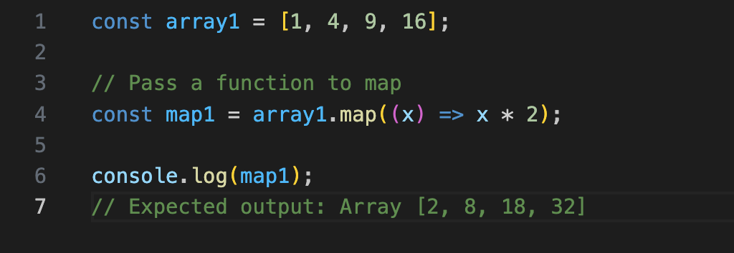
JavaScript (TS) refresher
Map

Slide 9
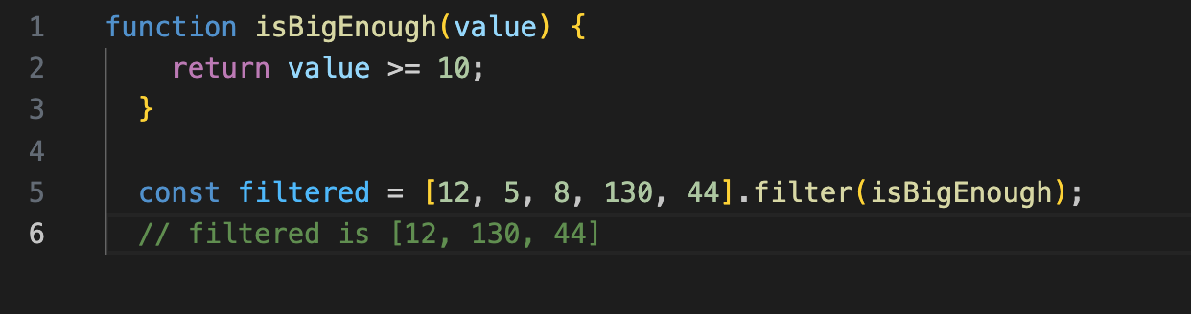
JavaScript (TS) refresher
Filter

Slide 10
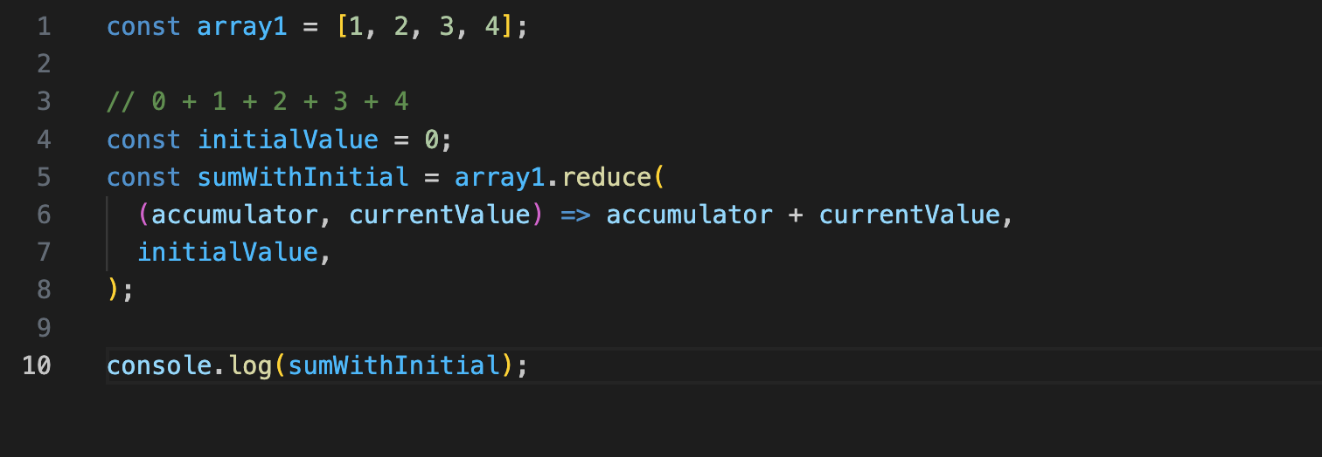
JavaScript (TS) refresher
Reduce

Slide 11
React 101
Setup
Ensure you have installed and setup a proper JS runtime environment with node and npm
Copy the Github source code onto your machine:
https://github.com/marcus-yeagle/react-tutorial

Slide 12
Demo

Slide 13

React 101 - Components
In React, a component is a piece of reusable code that represents a part of a user interface. Components are used to render, manage, and update the UI elements in your application. Let’s look at the component line by line to see what’s going on:
export default function Square() {
return <button className="square">X</button>;
}

Slide 14
React 101 - Components
In React, a component is a piece of reusable code that represents a part of a user interface. Components are used to render, manage, and update the UI elements in your application. Let’s look at the component line by line to see what’s going on:
export default function Square() {
return <button className="square">X</button>;
}

Slide 15

React 101 - Components
export default function Square() {
return (
<>
<button className="square">X</button>
<button className="square">X</button>
</>
);
}

Slide 16
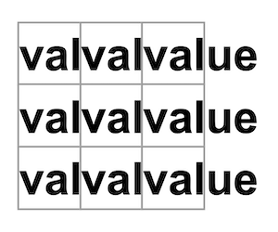
React 101 - Components
function Square({ value }) {
return <button className="square">value</button>;
}

Slide 17
React 101 - Components
function Square({ value }) {
return <button className="square">{value}</button>;
}

Slide 18
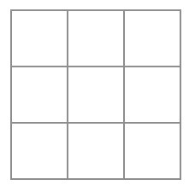
React 101 - Components
function Square({ value }) {
return <button className="square">{value}</button>;
}

Slide 19
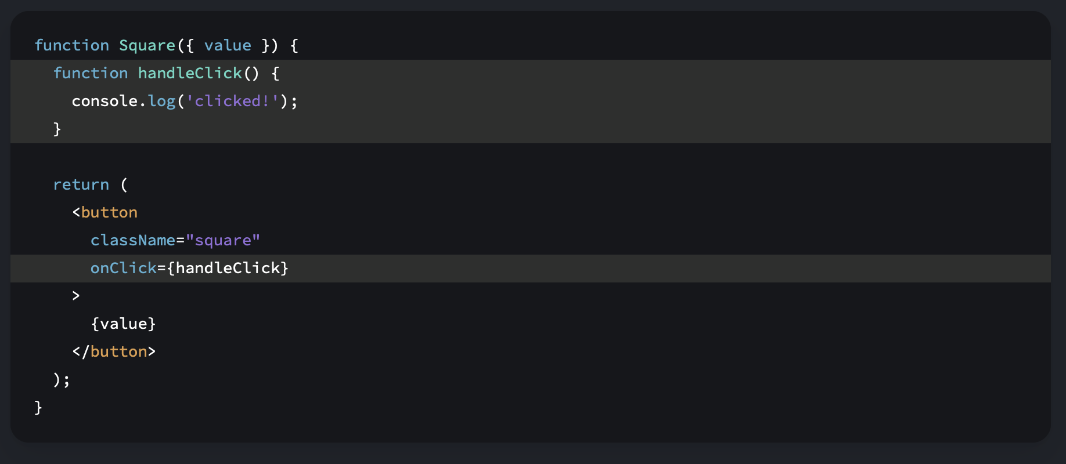
React 101 - Components

Slide 20
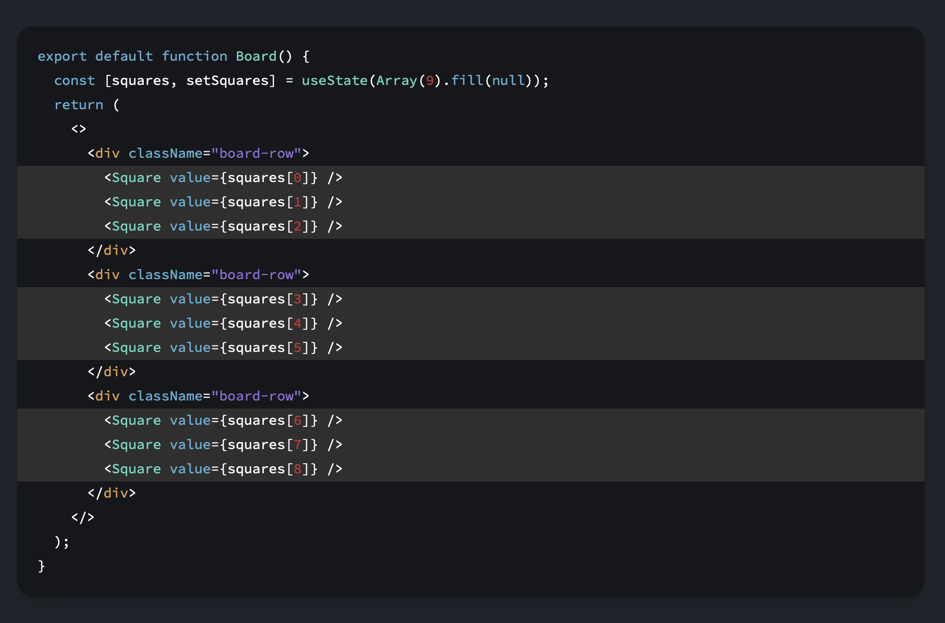
React 101 - Components
['O', null, 'X', 'X', 'X', 'O', 'O', null, null]

Slide 21
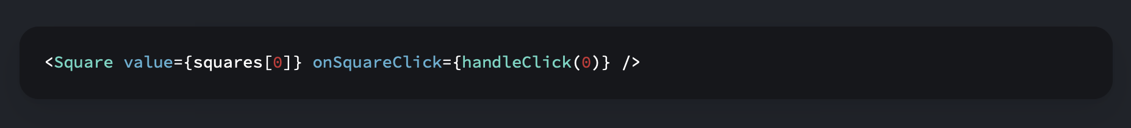
React 101 - Components

Slide 22
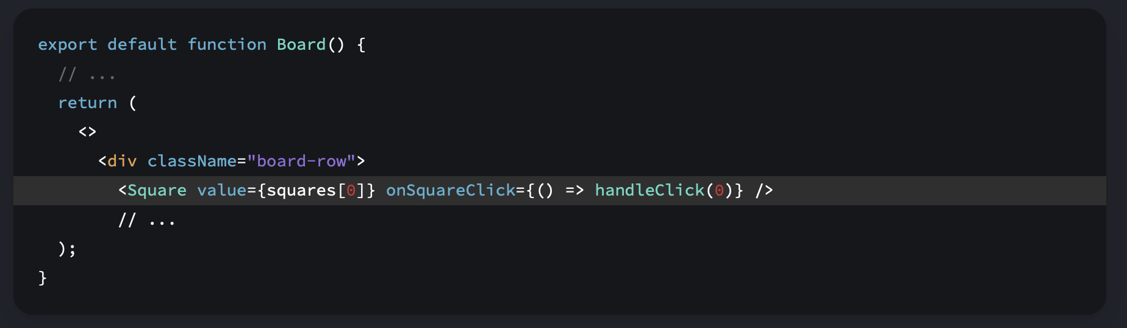
React 101 - Components

Slide 23
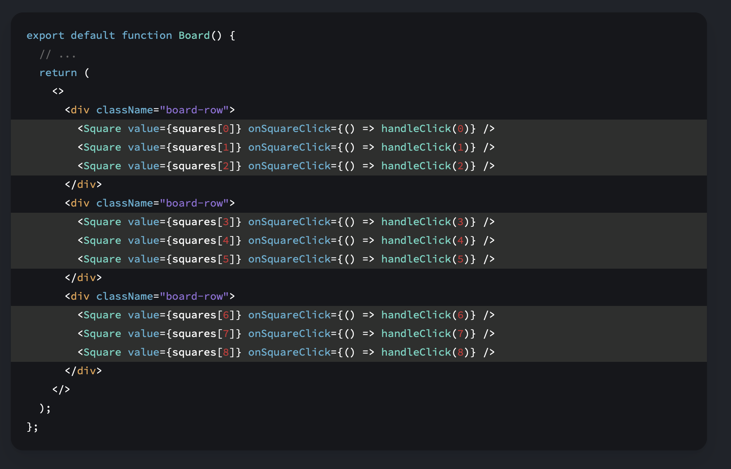
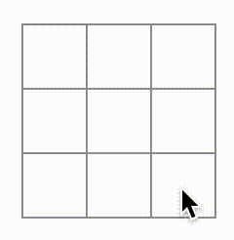
React 101 - Components

Slide 24
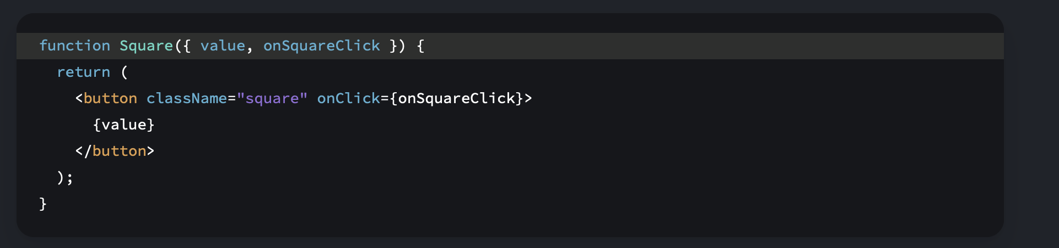
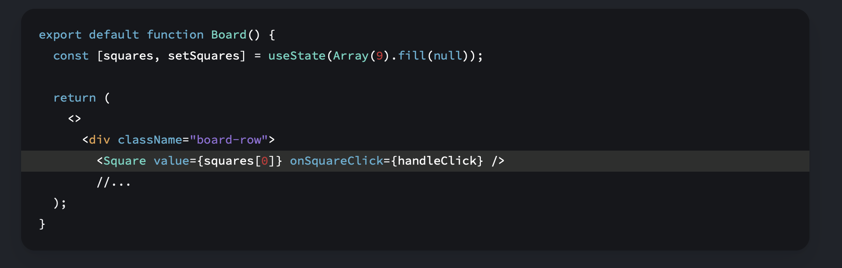
React 101 - Components

Slide 25
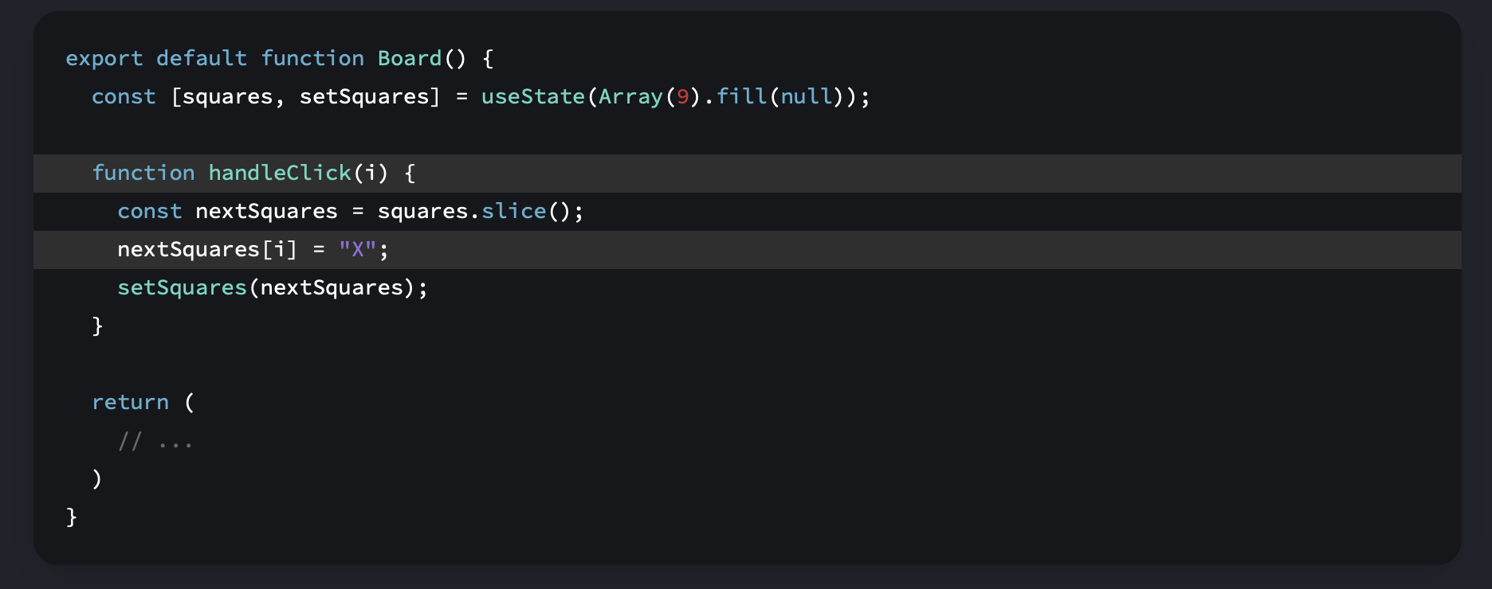
React 101 – Component State
The handleClick function creates a copy of the squares array (nextSquares) with the JavaScript slice() Array method. Then, handleClick updates the nextSquares array to add X to the first ([0] index) square.
Calling the setSquares function lets React know the state of the component has changed. This will trigger a re-render of the components that use the squares state (Board) as well as its child components (the Square components that make up the board).

Slide 26
React 101 – Component State
The handleClick function creates a copy of the squares array (nextSquares) with the JavaScript slice() Array method. Then, handleClick updates the nextSquares array to add X to the first ([0] index) square.
Calling the setSquares function lets React know the state of the component has changed. This will trigger a re-render of the components that use the squares state (Board) as well as its child components (the Square components that make up the board).

Slide 27
React 101 – Component State
- Now that your state handling is in the Board component, the parent Board component passes props to the child Square components so that they can be displayed correctly.
B
S1
S2
S2
...
B
S1
S2

Slide 28
React 101 – Component State
- Now that your state handling is in the Board component, the parent Board component passes props to the child Square components so that they can be displayed correctly.
- When clicking on a Square, the child Square component now asks the parent Board component to update the state of the board.
B
S1
S2
...
B
S1
S2

Slide 29
React 101 – Component State
- Now that your state handling is in the Board component, the parent Board component passes props to the child Square components so that they can be displayed correctly.
- When clicking on a Square, the child Square component now asks the parent Board component to update the state of the board.
- When the Board’s state changes, both the Board component and every child Square re-renders automatically.
- Keeping the state of all squares in the Board component will allow it to determine the winner in the future.
B
S1
S2
...
B
S1
S2

Slide 30
React 101 – Immutability
There are generally two approaches to changing data.
The first approach is to mutate the data by directly changing the data’s values.
const squares = [null, null, null, null, null, null … ];
squares[0] = ‘X’;
The second approach is to replace the data with a new copy which has the desired changes. Here is what it would look like if you mutated the squares array:
const squares = [null, null, null, null, null, null … ];
const nextSquares = [‘X’, null, null, null, null, null … ];
There is also another benefit of immutability: By default, all child components re-render automatically when the state of a parent component changes.
This includes even the child components that weren’t affected by the change. Although re-rendering is not by itself noticeable to the user (you shouldn’t actively try to avoid it!), you might want to skip re-rendering a part of the tree that clearly wasn’t affected by it for performance reasons.
Immutability makes it very cheap for components to compare whether their data has changed or not.

Slide 31
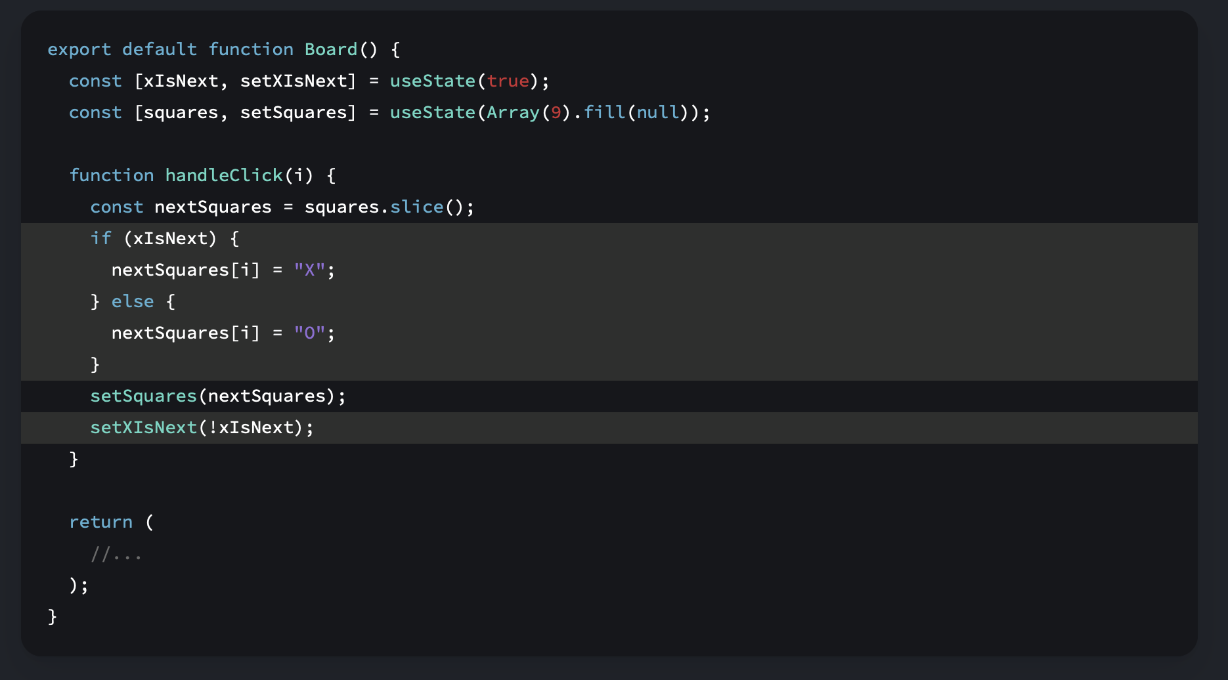
React 101 – Component Logic

Slide 32
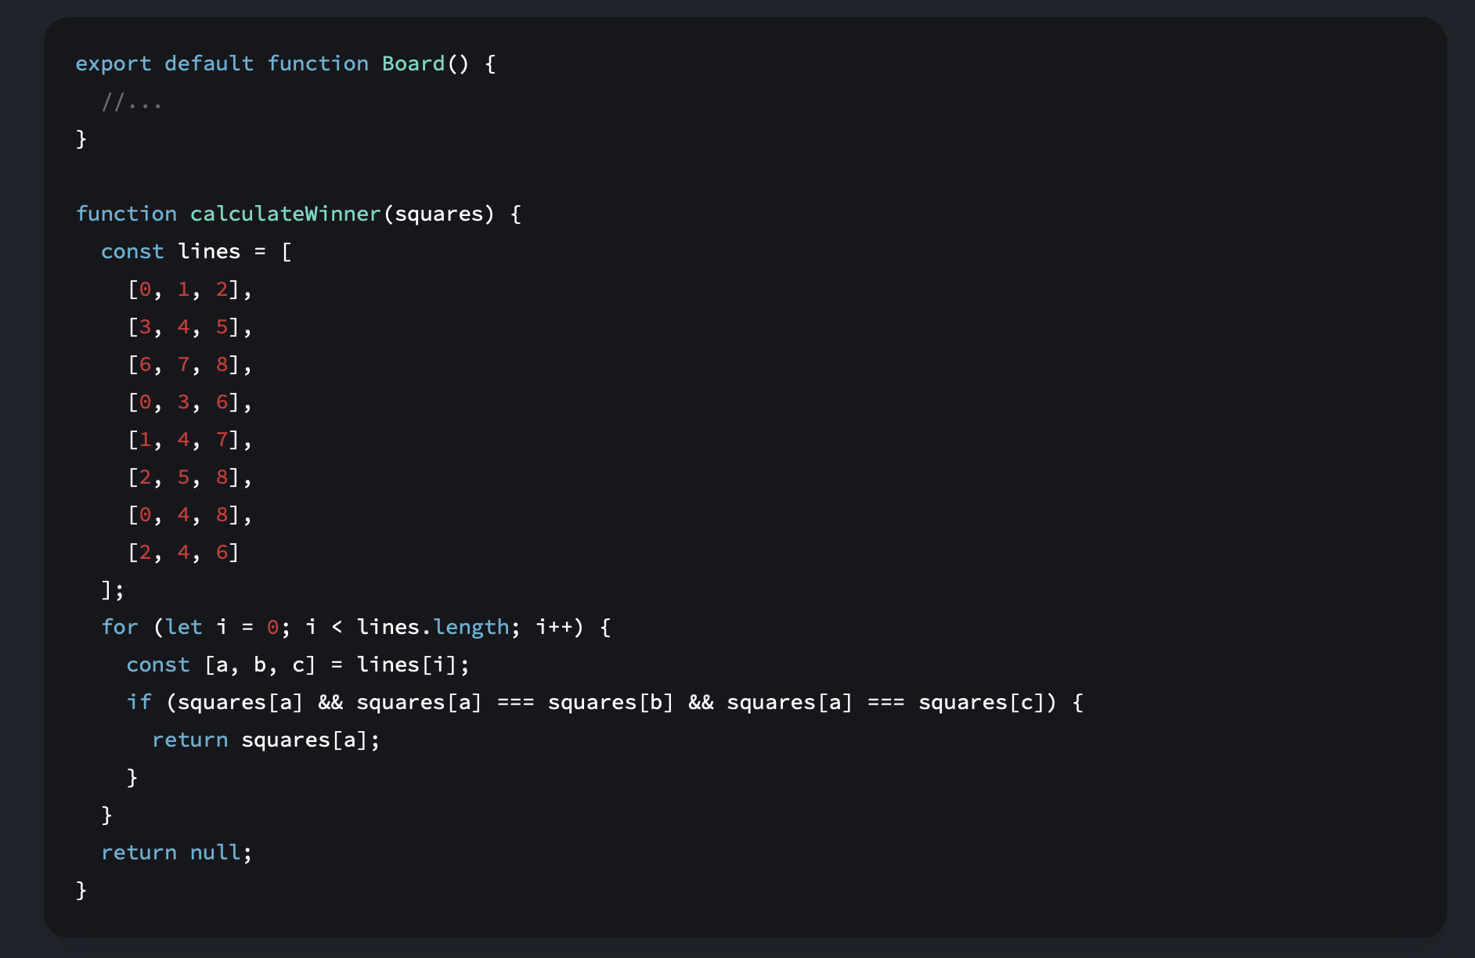
React 101 – Component Logic

Slide 33
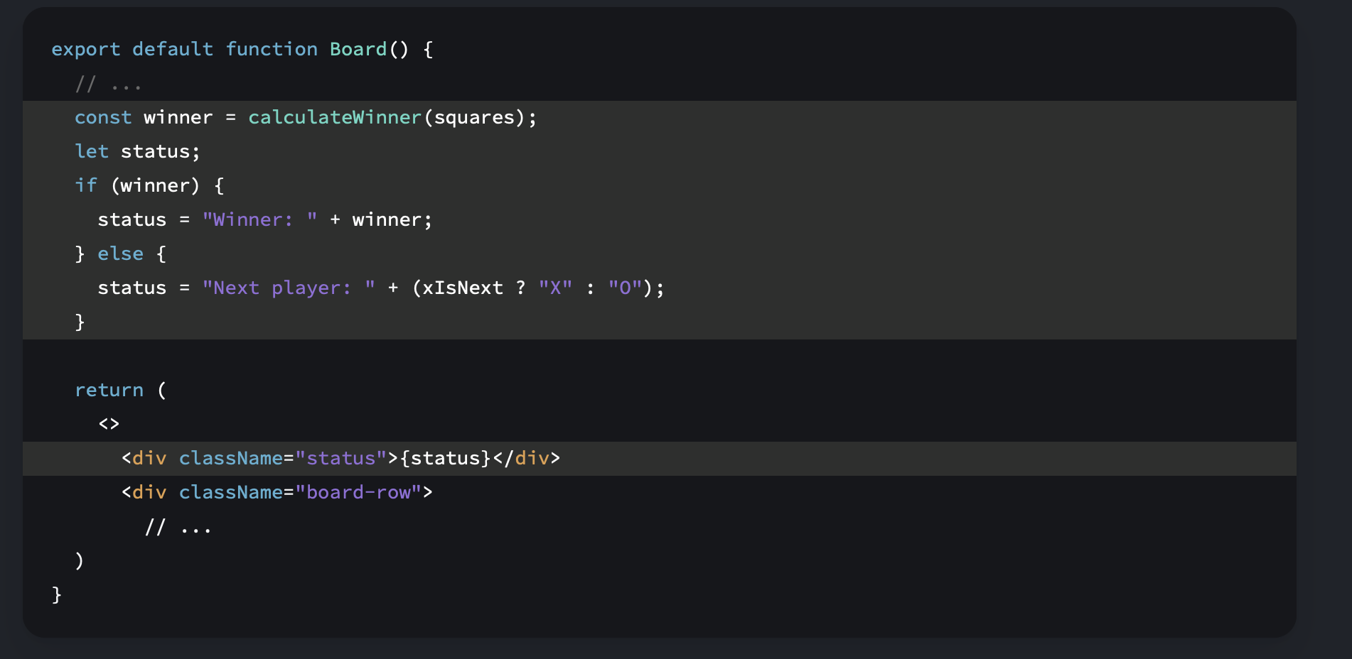
React 101 – Component Logic

Slide 34
A.I. Development – GPT

Slide 35


Further Learning – Resources
Books
- Structure and Interpretation of Computer Programs (SICP)
- Paradigms of Artificial Intelligence Programming: Case studies in Common Lisp
(PAIP)
Videos
- Learning Functional Programming with JavaScript - Anjana Vakil - JSUnconf
- A Flock of Functions: Lambda Calculus and Combinatory Logic in JavaScript | Gabriel Lebec @ DevTalks

